Slide 1
Q8 Express
Presented By:
JOMY MATHEW
SJC17MCA-D021

Slide 2
In this project we are handling the Administrative module of Q8 Express.
Master Settings and Website Management is the modules of Admin module.
The Master Settings consists of Manage Currency, Unit, Category Images, Home Page Banner, State, Security Questions.
The Website Management consists of Manage Properties
In this module the admin can manage, search and view item.
Add, search and view Currency.
Add, search and view Unit.
Add, search and view Category Images.
Add, search and view Home Page Banner.
Add, search and view State.
Add, search and view Security Questions.
Add, search and view Properties.

Slide 3
USER CASE

Slide 4
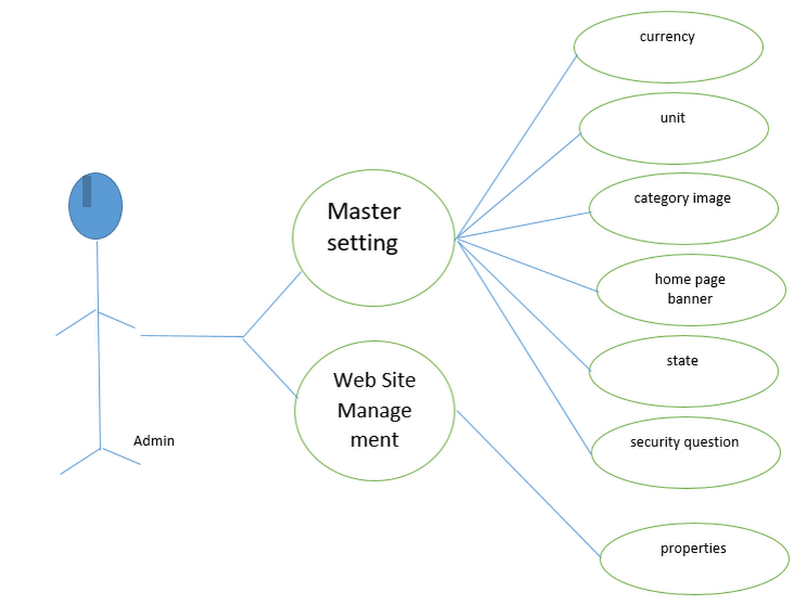

Slide 5
DATAFLOW DIAGRAM

Slide 6
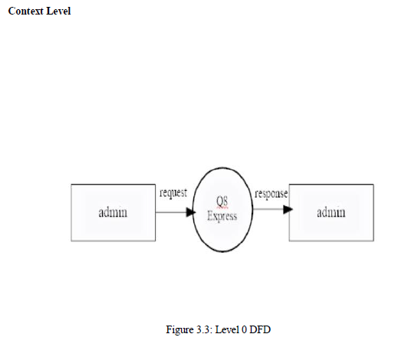
Context Diagram

Slide 7
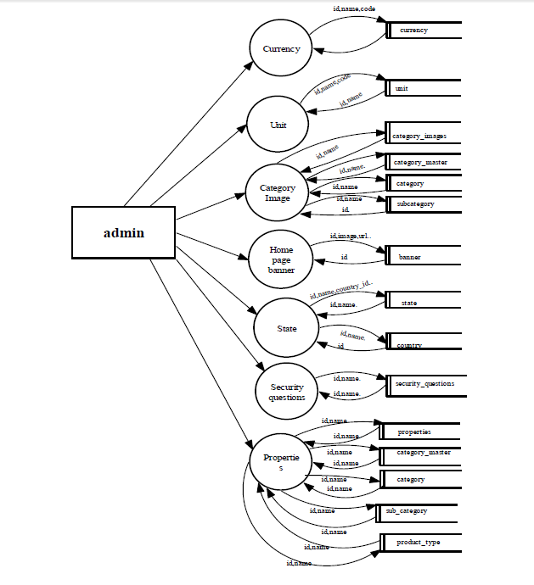
Level-1 DFD

Slide 8
SEQUENCE DIAGRAM

Slide 9
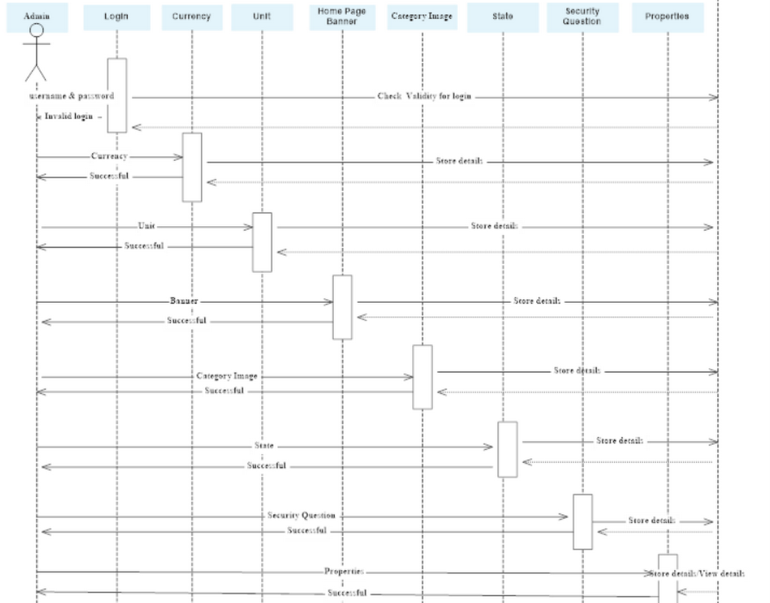

Slide 10
ACTIVITY DIAGRAM

Slide 11
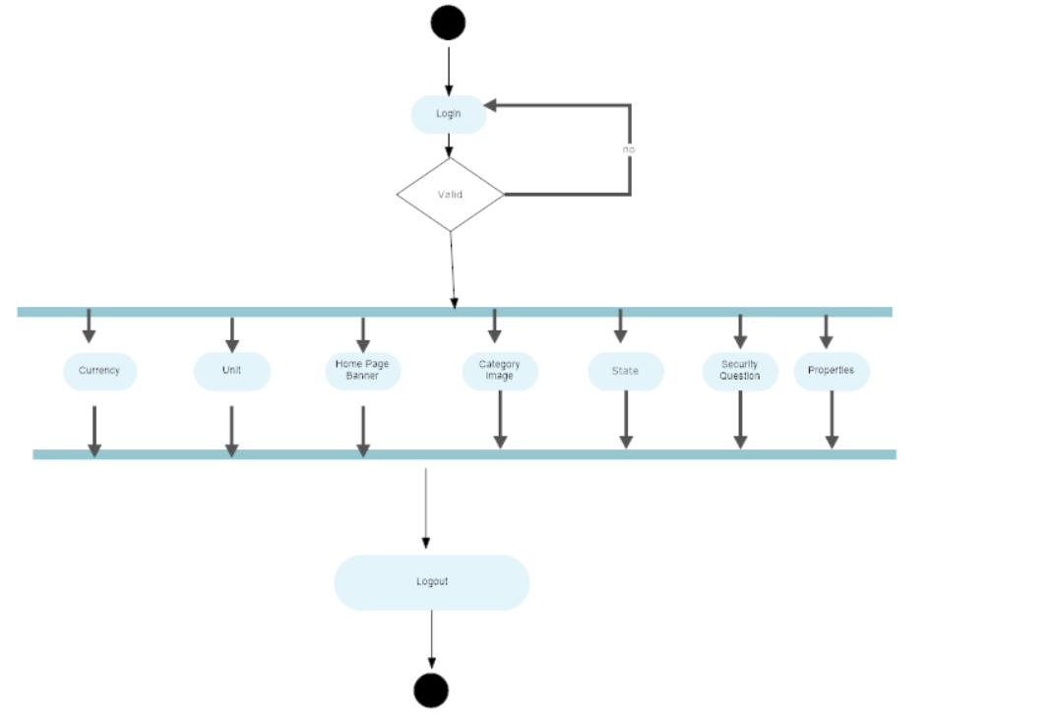

Slide 12
UI Design

Slide 13
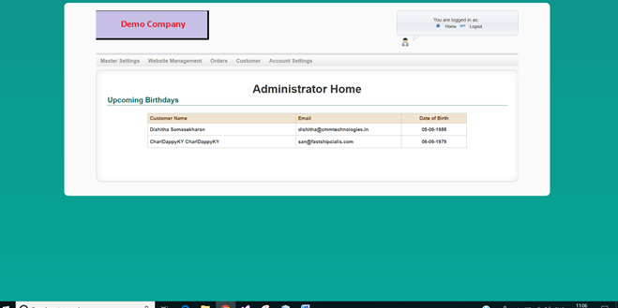
Main page of Admin

Slide 14
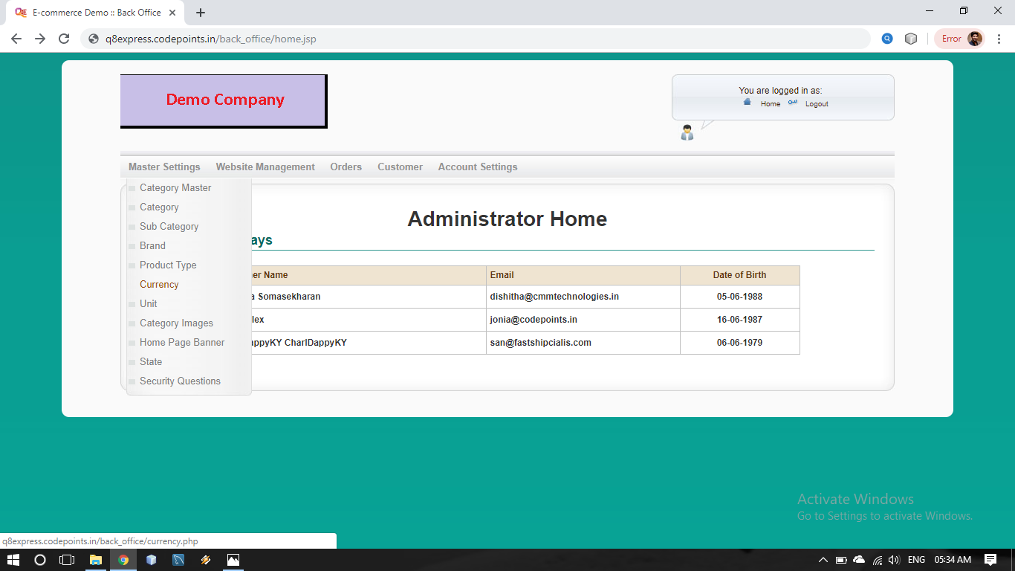
Master Settings

Slide 15
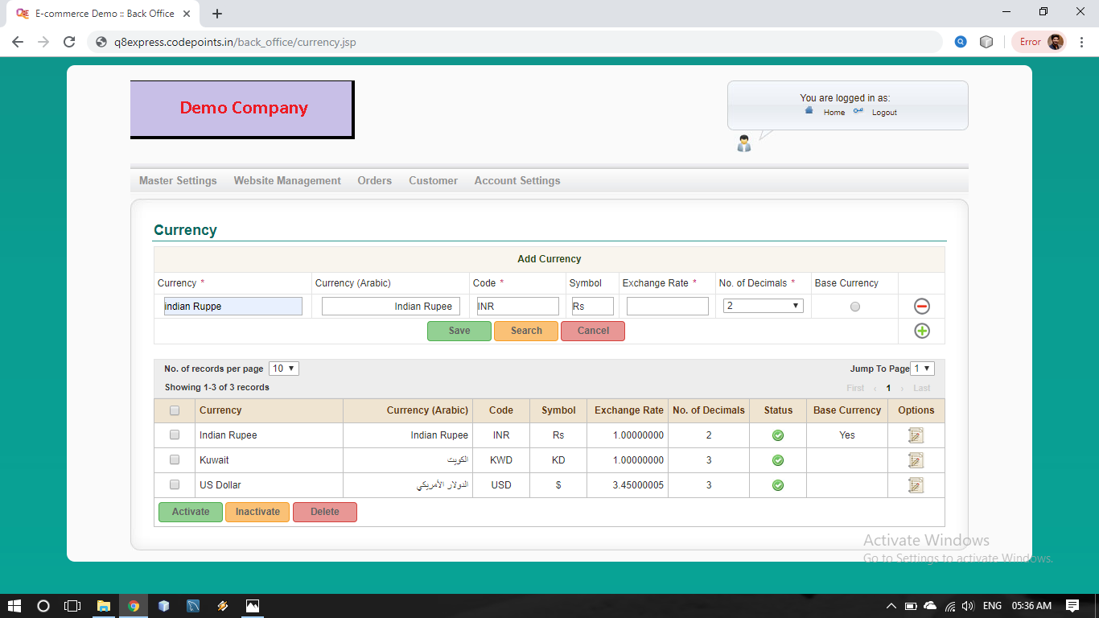
1.1 .Add Currency

Slide 16
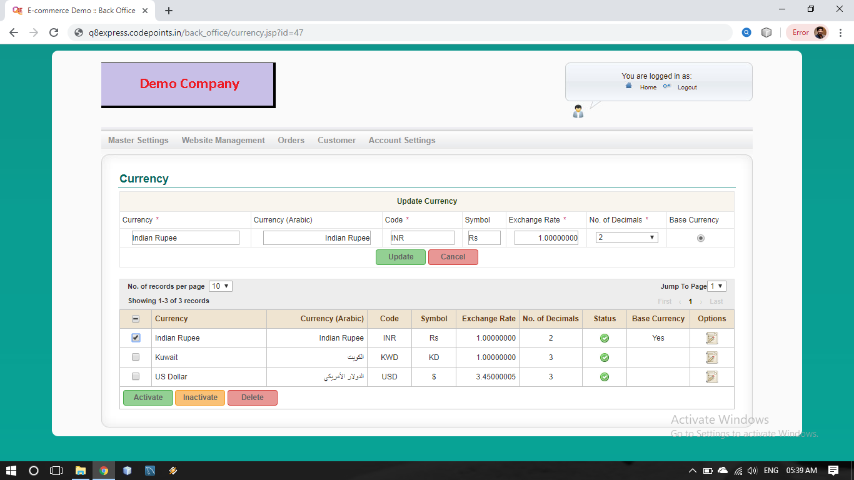
1.2 Update Currency

Slide 17
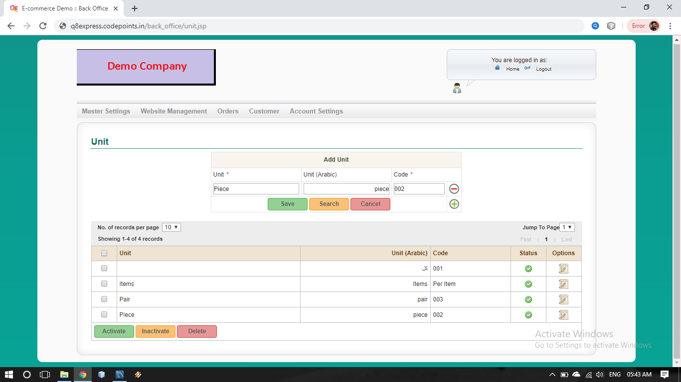
2.1 Add Unit

Slide 18
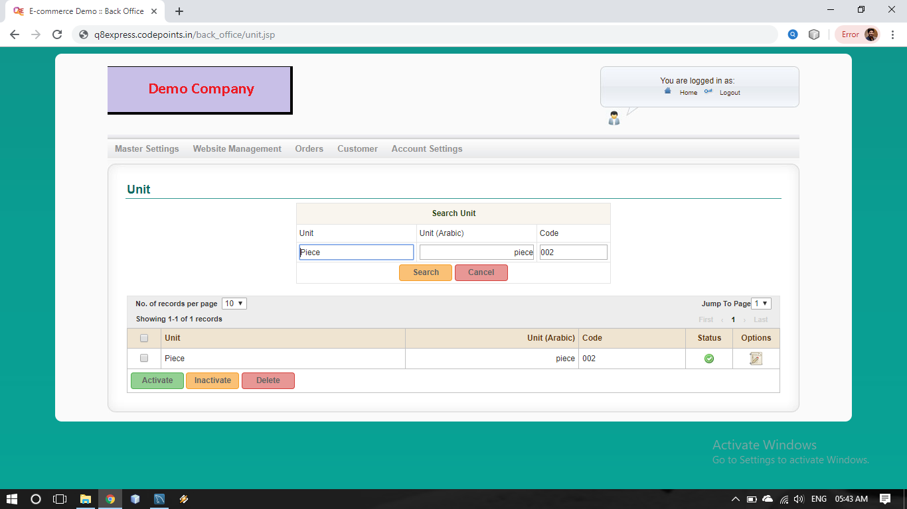
2.2 Search Unit

Slide 19
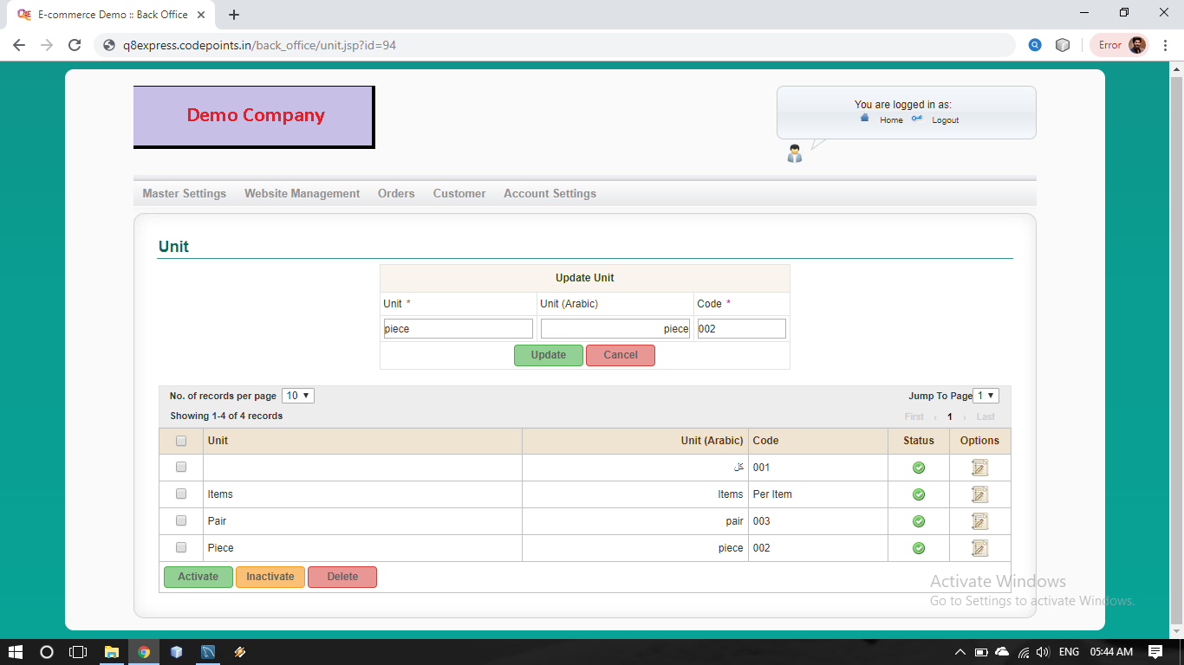
2.3 Update Unit

Slide 20
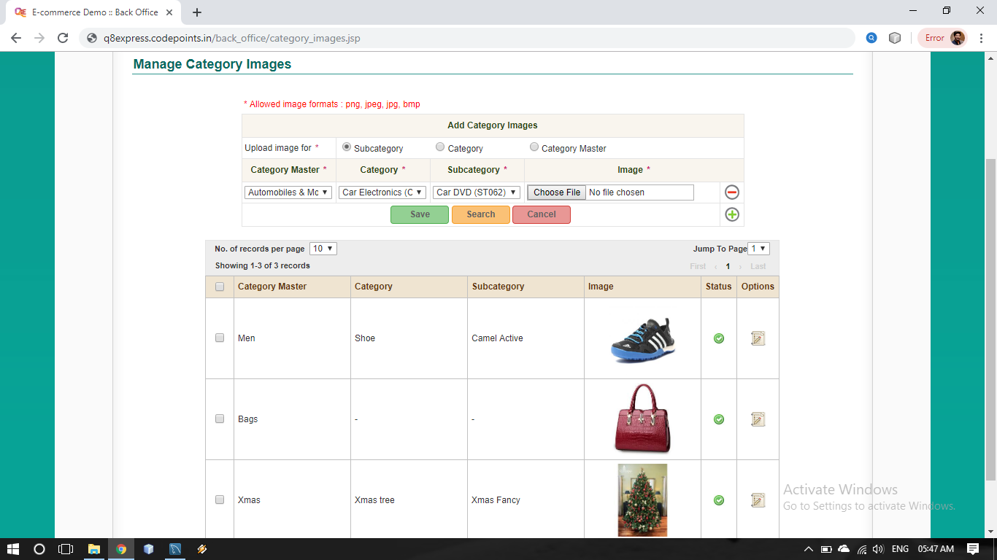
3.1 Add Sub category Image

Slide 21
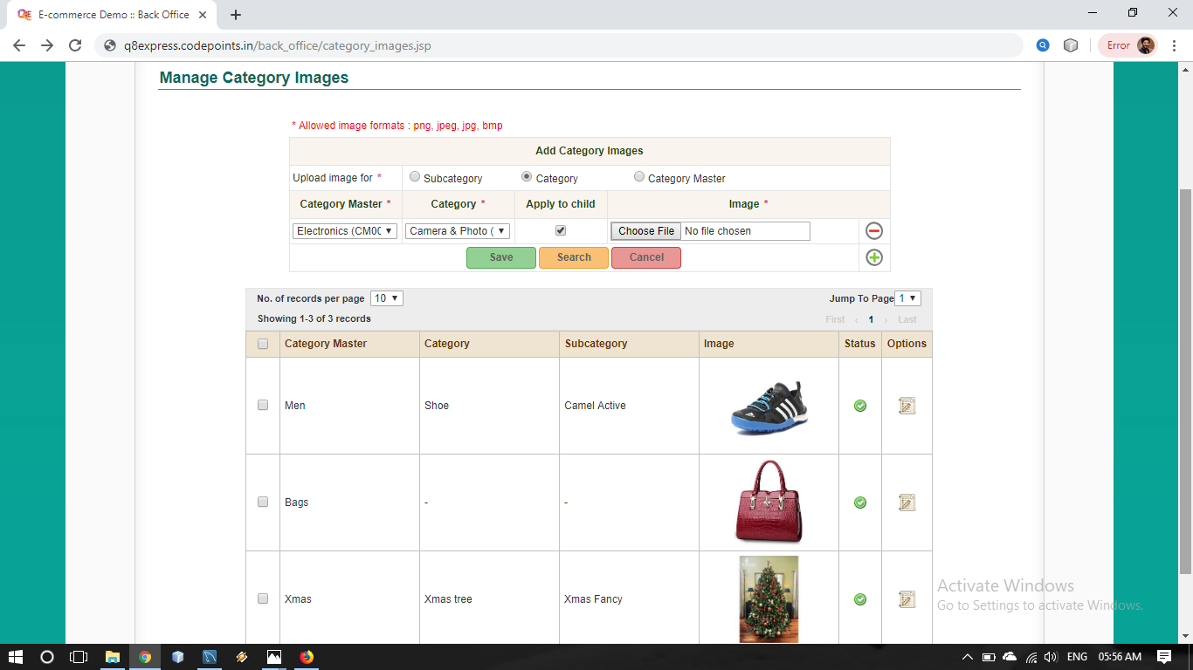
3.2 Add category Image

Slide 22
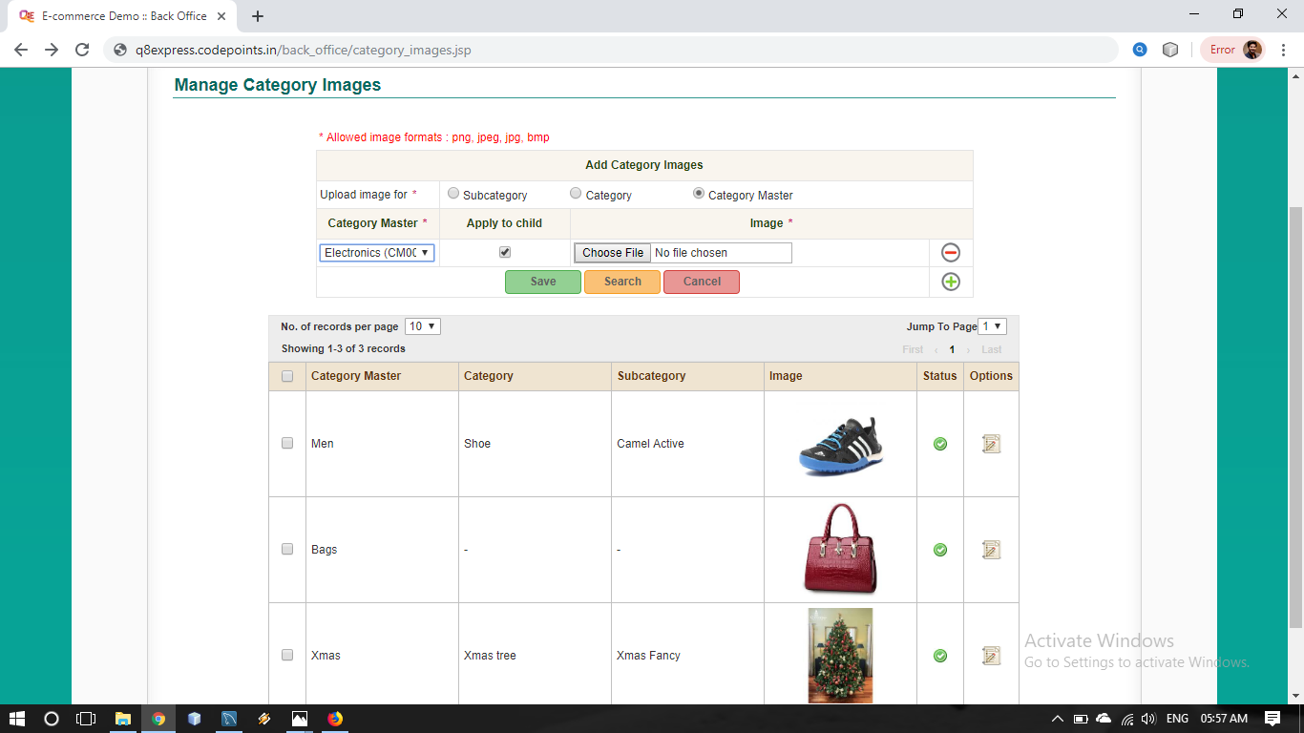
3.3 Add category master Image

Slide 23
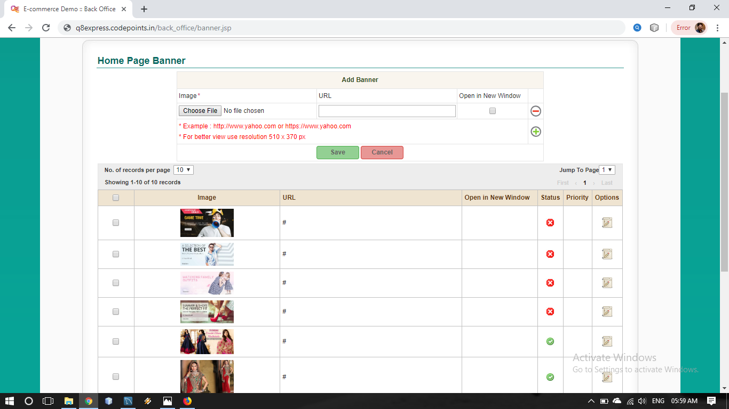
4.1 Add Home page banner

Slide 24
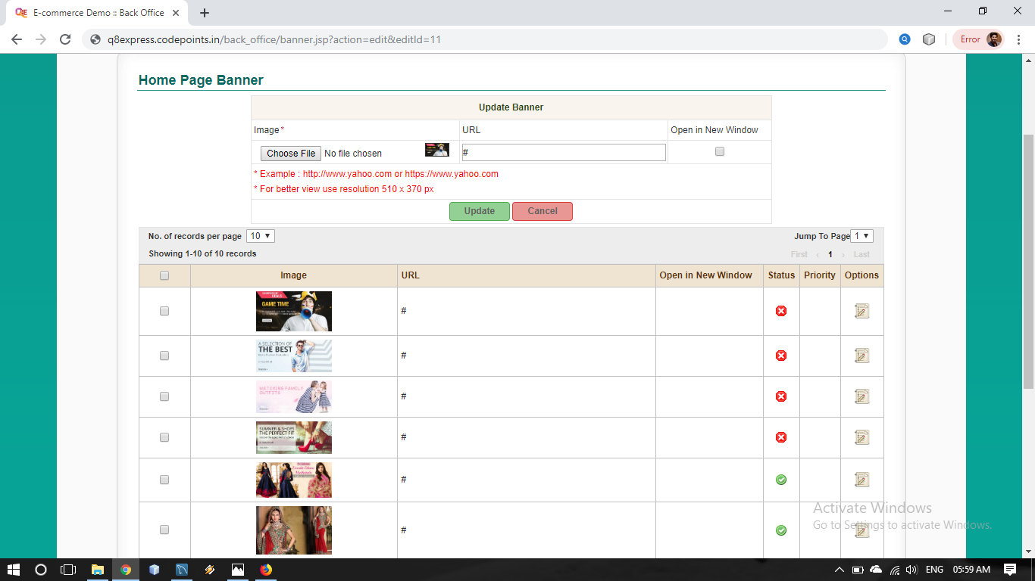
4.2 Update Home page banner

Slide 25
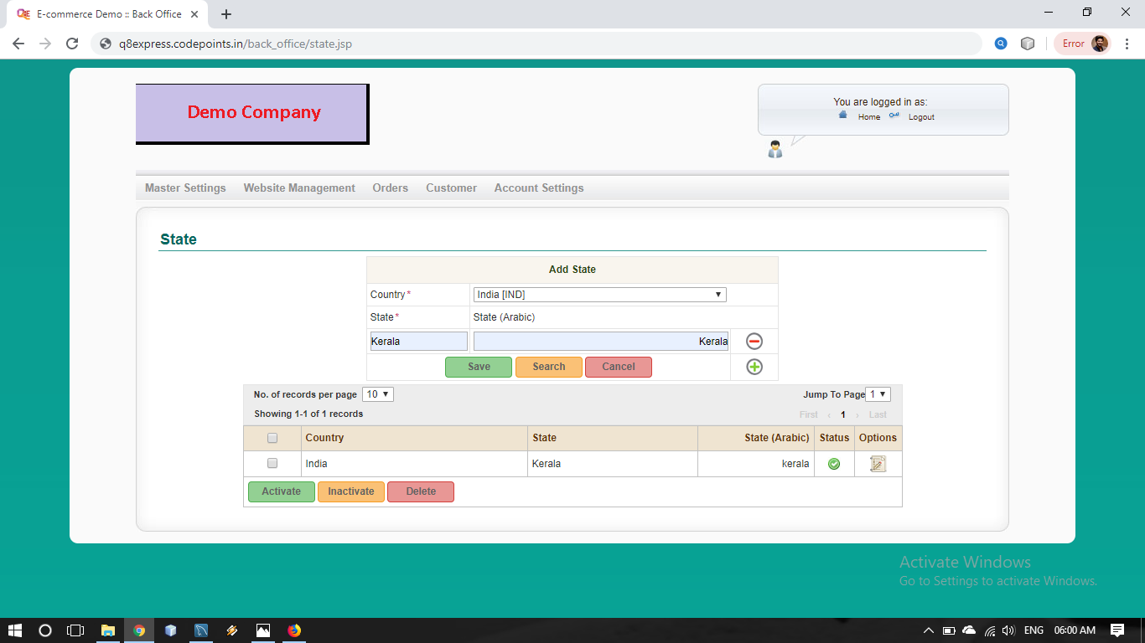
5.1 Add State

Slide 26
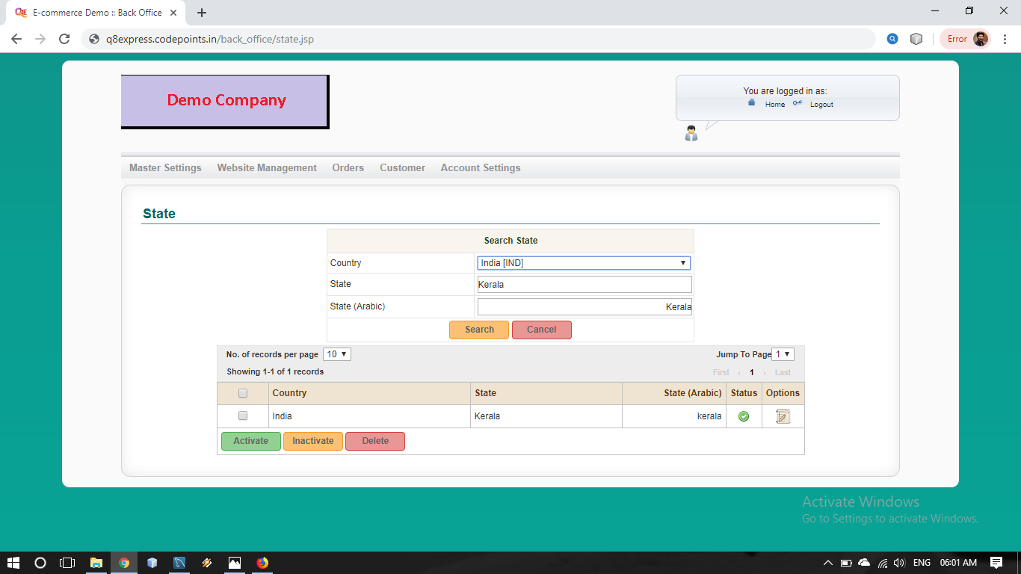
5.2 Search State

Slide 27
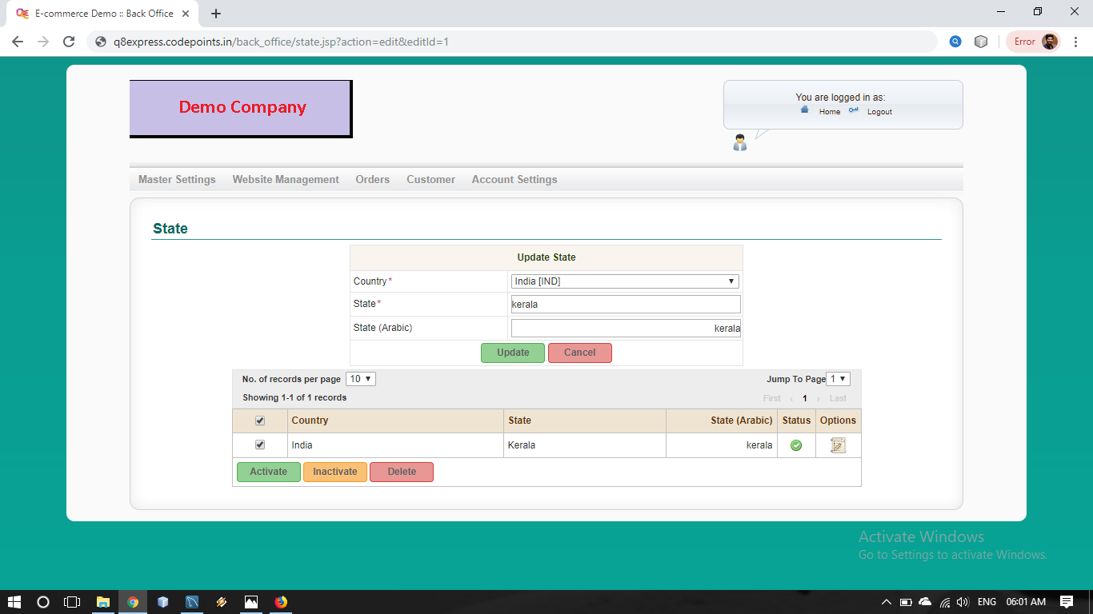
5.3 Update State

Slide 28
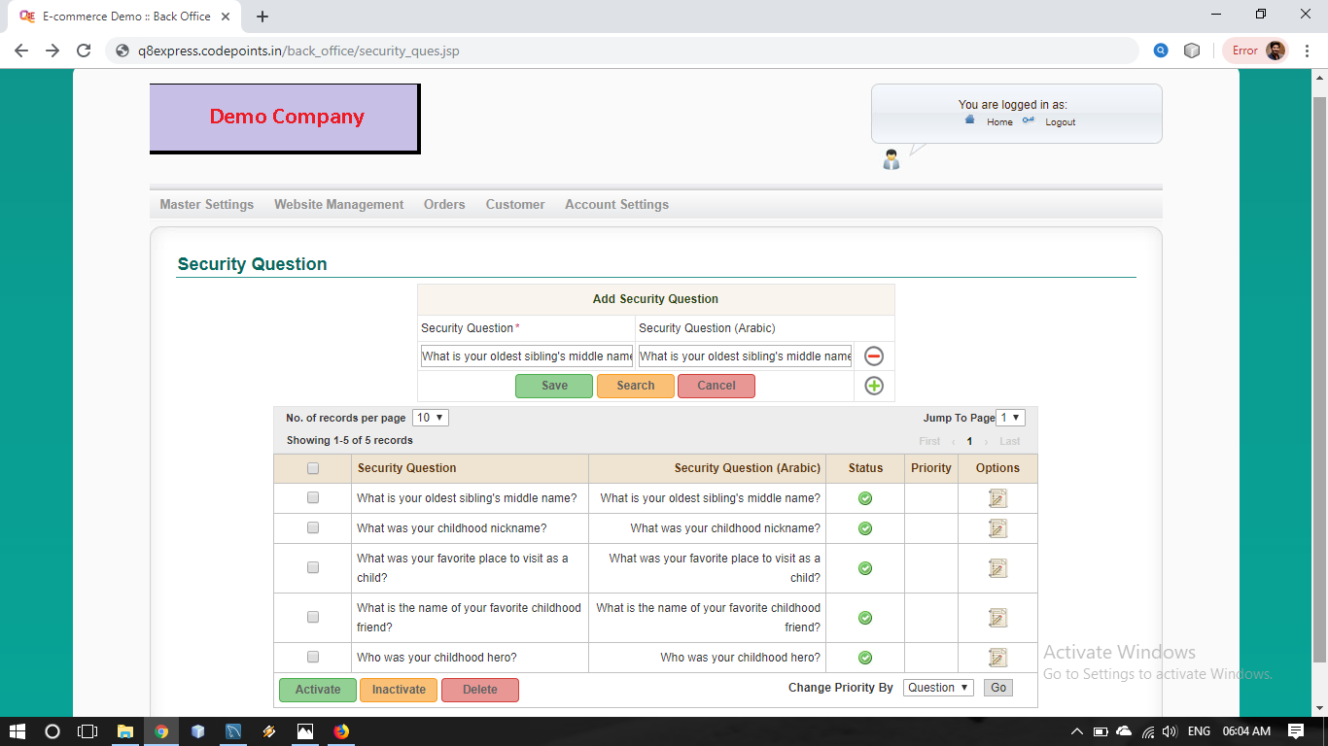
6.1 Add Security question

Slide 29
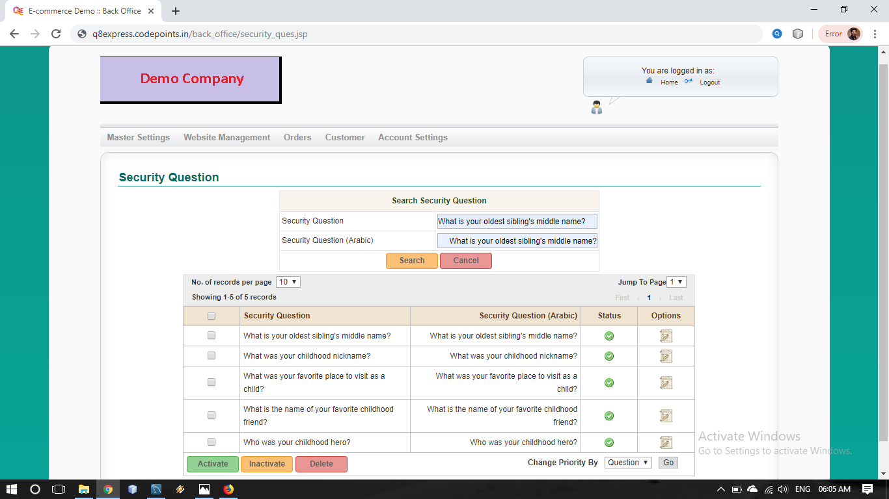
6.2 Search Security question

Slide 30
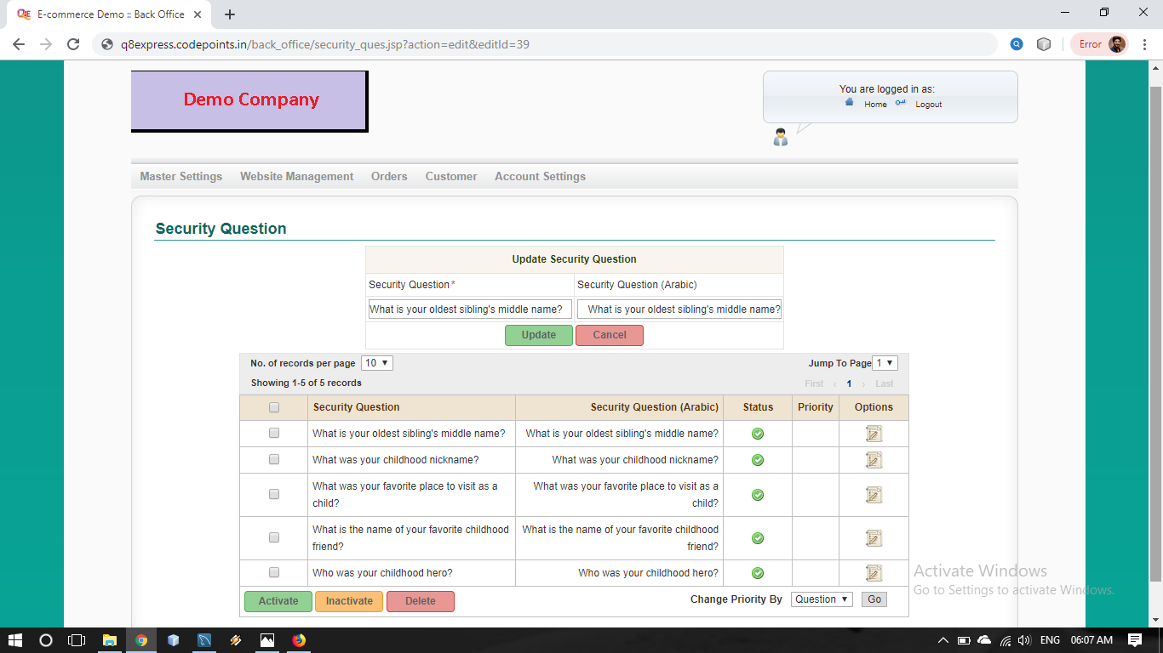
6.3 Update Security question

Slide 31
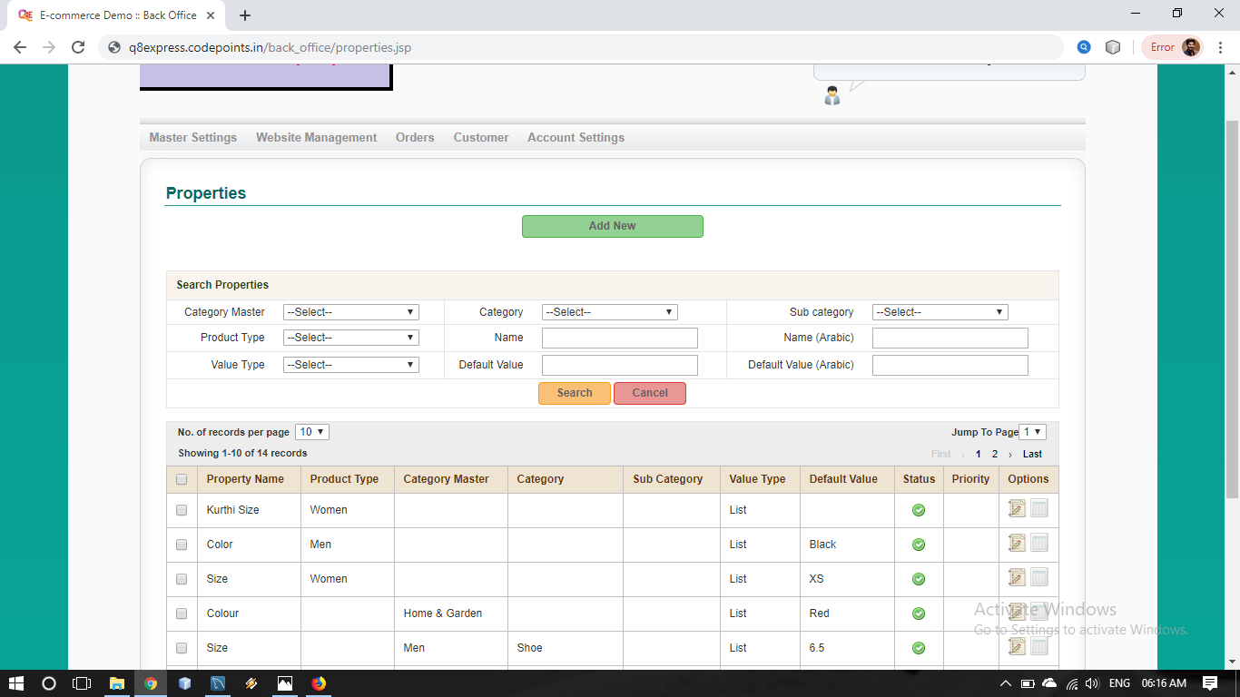
Web Site Management
7.1 Search Properties

Slide 32
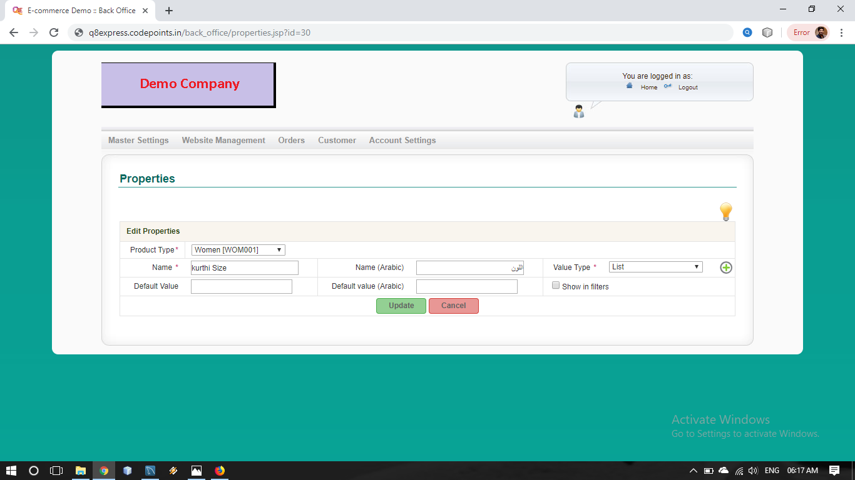
7.2 Update Properties

Slide 33
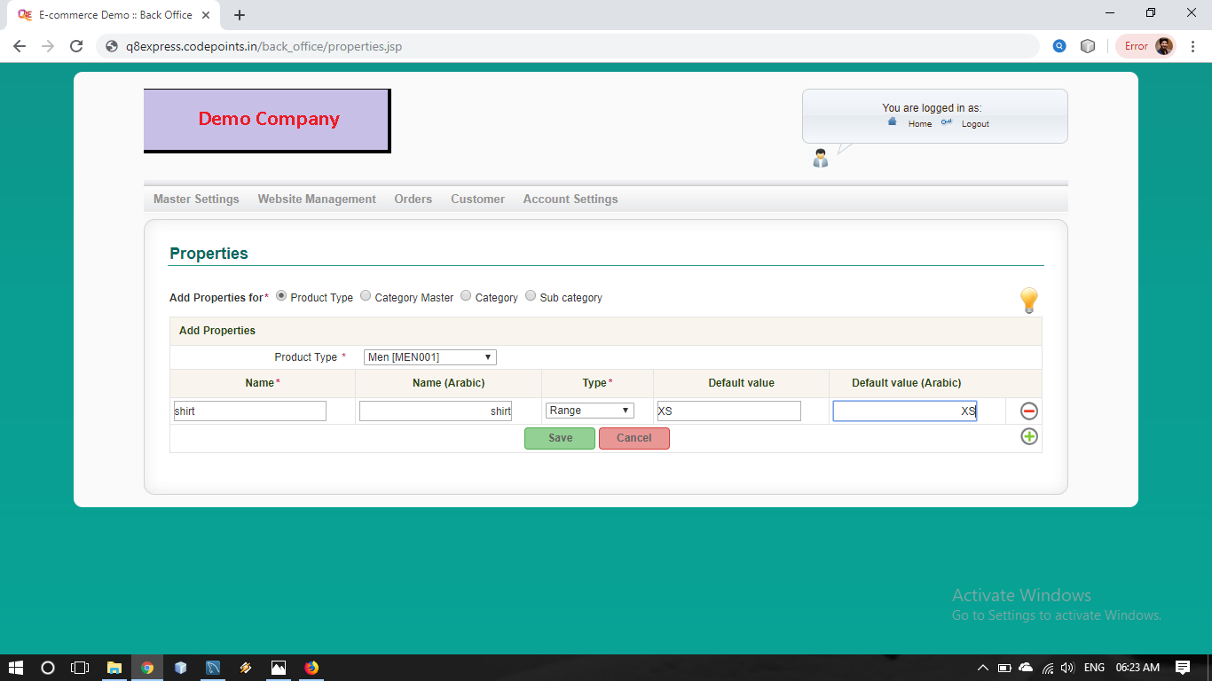
7.3 Add Properties

Slide 34
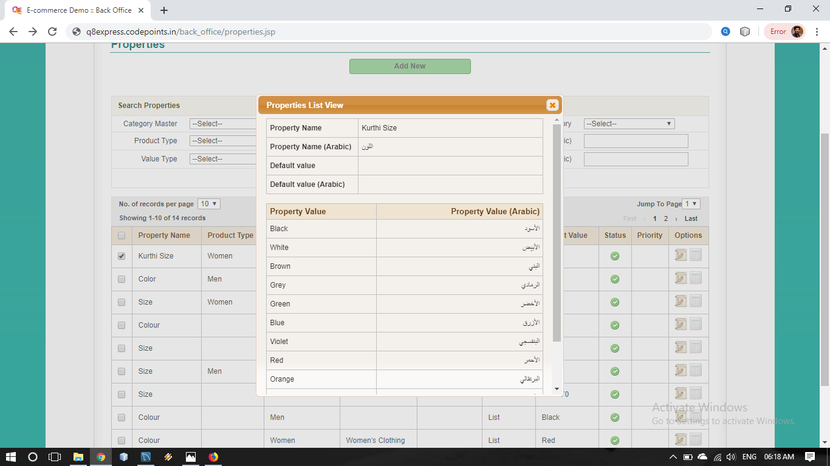
7.4 View Properties

Slide 35
TABLE DESIGN

Slide 36
Currency
Field name | DataType | Constrains | Description
id | BIGINT(20) | PRIMARY KEY | Currency id
name | VARCHAR(100) | Not Null | Currency name
name_ar | VARCHAR(100) | Null | Currency Name in Arabic
code | VARCHAR(10) | Not Null | Currency code
symbol | VARCHAR(5) | Not Null | Currency symbol
exchange_rate | FLOAT(16,8) | Not Null | Currency Rate
decimals | ENUM('0', '1', '2', '3', '4', '5') | Not Null | Number of points after decimal
is_base | ENUM('Yes', 'No') | Not Null | Base Currency
status | ENUM('Active', 'Inactive') | Not Null | Currency status

Slide 37
2. Unit
Field name | DataType | Constrains | Description
id | BIGINT(20) | PRIMARY KEY | Unit id
name | VARCHAR(100) | Not Null | Unit Name
name_ar | VARCHAR(100) | Null | Unit Name in arabic
code | VARCHAR(10) | Not Null | Unit code
status | ENUM('Active', 'Inactive') | Not Null | Unit status

Slide 38
3. Category images
Field name | DataType | Constrains | Description
Id | BIGINT(20) | PRIMARY KEY | Category images id
category_master_id | BIGINT(20) | FOREIGN KEY | category_ master_id
category_id | BIGINT(20) | FOREIGN KEY | category_id
sub_category_id | BIGINT(20) | FOREIGN KEY | sub_category _id
apply_to_child | ENUM('Yes', 'No') | Not Null | Image apply for children
image | VARCHAR(500) | Not Null | Image file
status | ENUM('Active', 'Inactive') | Not Null | category_ images Status

Slide 39
4. Banner
Field name | DataType | Constrains | Description
id | BIGINT(20) | PRIMARY KEY | Banner id
image | VARCHAR(100) | NOT NULL | Image file
url | VARCHAR(100) | NOT NULL | Banner url
target | ENUM('_SELF', '_BLANK') | NOT NULL | Banner target
priority | INT(10) | NOT NULL | Banner priority
status | ENUM('Active', 'Inactive') | NOT NULL | Banner status

Slide 40
5. State
Field name | DataType | Constrains | Description
id | BIGINT(20) | PRIMARY KEY | State id
name | VARCHAR(100) | Not Null | State name
name_ar | VARCHAR(100) | Null | State name in arabic
country_id | BIGINT(20) | Foreign key | country id
status | ENUM('Active', 'Inactive') | Not Null | State status

Slide 41
6. Security Questions
Field name | DataType | Constrains | Description
Id | BIGINT(20) | PRIMARY KEY | security_ questions id
question | VARCHAR(250) | Not Null | security_questions
question_ar | VARCHAR(250) | Null | security_questions in arabic
priority | INT(10) | Not Null | security_ questions priority
status | ENUM('Active', 'Inactive') | Not Null | security_ questions status

Slide 42
7. Properties
Field name | DataType | Constrains | Description
Id | BIGINT(20) | PRIMARY KEY | Properties id
category_master_id | BIGINT(20) | Foreign Key | category_ master_id
category_id | BIGINT(20) | Foreign Key | category_id
sub_category_id | BIGINT(20) | Foreign Key | sub_ category_id
product_type_id | BIGINT(20) | Foreign Key | Product _type_id
name | VARCHAR(100) | Not Null | Properties name
name_ar | VARCHAR(100) | Null | Properties name in arabic
type | ENUM('Range', 'Number', 'Text', 'List') | Not Null | Properties type
default_value | VARCHAR(500) | Null | Properties Default value
default_value_ar | VARCHAR(500) | Null | Properties Default value in arabic
show_in_filters | ENUM('Yes', 'No') | No | Properties filter
property_group_id | BIGINT(20) | Foreign Key | property_ group_id
priority | INT(10) | Not Null | Properties priority
status | ENUM('Active', 'Inactive') | Not Null | Properties status

